Slide 1
AIR POLLUTION MONITORING, FORECASTING
AND CONTROLLING SYSTEM
Project Reference No.: 46S_BE_4800
B.M.S. COLLEGE OF ENGINEERING
INFORMATION SCIENCE AND ENGINEERING
Student(s) Name:
1. Prateek M Gummaraju
2. Ruchi Agarwal
3. Samartha S
Guide Name:
1. Prof. Pallavi B

Slide 2
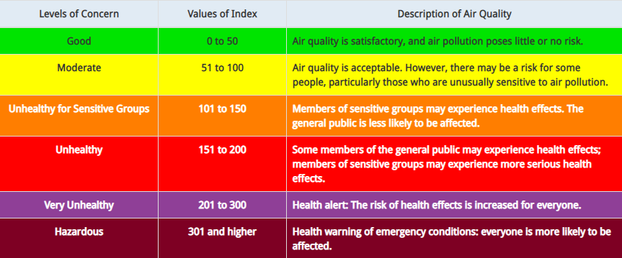
Introduction
Air pollution is defined as the presence of compounds in the atmosphere that are harmful to human beings and other living organisms
Has severe effects on human health - Respiratory issues, lungs and heart problems
Offering a holistic approach to tackle the issue of air pollution by building a device that can monitor air pollution, predict future levels of pollution and also suggest precautionary actions and methods to reduce air pollution

Slide 3
Motivation
Air pollution claims 7 million lives a year making it the most dangerous type of pollution
No present technology that is implemented on a large scale in urban areas
Lack of effective mobile apps
Lack of awareness
Demonstrate the possibility of a device to tackle to this problem which is:
  Cost effective
  Compact
  Easy to use
Help Bengaluru remain the Garden City of India for many years to come

Slide 4
Objectives
Build an IoT system to monitor Air Quality:
  a) Monitor Concentrations of different air pollutants
  b) Measure AQI
Build a model to predict the Air Quality in the near future, using the output of the IoT system as input.
Build a web application to display the real time findings.
Provide analytics on the website, such as current AQI and the forecasted AQI levels
Provide measures to improve Air Quality.
Provide precautionary measures.

Slide 5
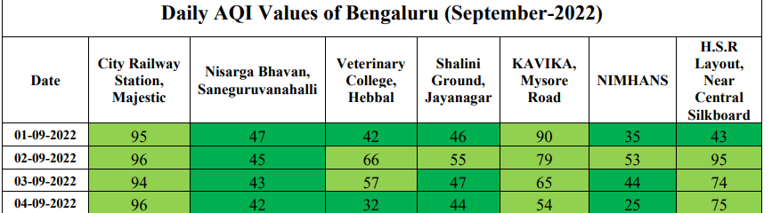
Existing System
Many AQI monitoring systems exist in the market. Many stations are present in Bangalore itself.
However, there are a very few websites that make use of the abundantly available data to forecast the future AQI. Those that do predict the AQI for Bengaluru as a whole. Here’s the problem with that approach:
Interestingly, during our research, we found out that the existing forecasts are pure timeseries based forecasts, without taking into account the external factors.

Slide 6
Proposed System
We propose to build an IoT device using Arduino Uno and several sensors to detect pollutants such as Particulate Matter, Ozone, Carbon Monoxide, etc. Using hourly values of these sensors, we will calculate the sub indices of each pollutant and hence the AQI. AQI will be calculated per day.
Using the AQI data collected from the open source database of CPCB and the IoT device, we aim to build a Machine Learning model to forecast the AQI for the coming few days in Jayanagar region.
Why only this region? Because the AQI at any given time varies all over Bangalore. Hence, if we can model one area accurately, repeating the same for all other areas should be easy.
We have built a website that displays:
  Current AQI
  Forecasted AQI for the next 5 days
  Control Measures and Precautionary Measures

Slide 7
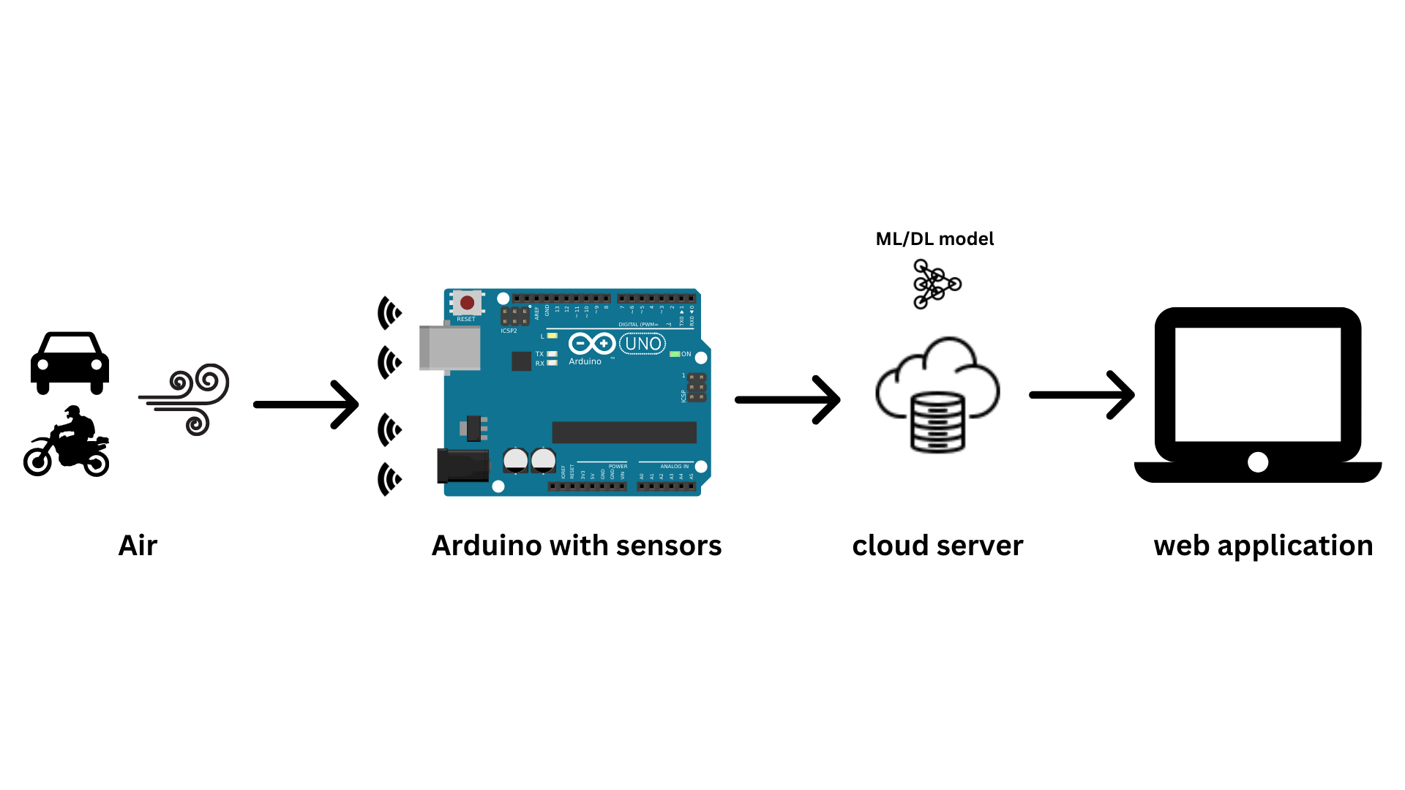
SYSTEM DESIGN
System Architecture

Slide 8
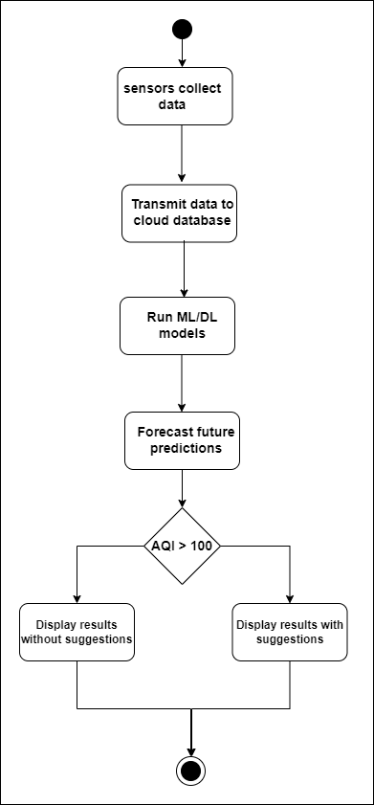
Activity Diagram

Slide 9
Methodology
Our system has 3 parts:
1. Monitoring
An IoT device will be built using Arduino as the microcontroller. We will use MQ135 Air Quality sensor, MQ131 Ozone sensor, MQ7 Carbon Monoxide sensor, and PM2.5 dust sensor. These sensors will measure the current concentrations of the various pollutants and will output the current AQI. The values of the concentrations of the gases is to be stored in a database, which will be used to forecast the future levels of AQI.
2. Forecasting
Using the data collected in the previous module, an ML model is to be trained to predict the future levels of AQI. Based on the literature survey, the AutoRegression model provided the best results.
3. Controlling
AQI is categorized into 6 categories based on the value. Depending on the category of the current AQI level, suggestions are to be provided to improve the category to ‘Good’.

Slide 10
RESULT
https://bmsaqiproject.netlify.app/

Slide 11
RESULT
MODEL (Parameters) | Mean Squared Error (MSE)
Predicting based on previous day | 577.05
AutoReg(lags=17, trend=’t’) | 917.961
ARMA: ARIMA(p=4, d=0, q=1, trend=’t’, exog=Null) | 449.86
ARIMA(p=3, d=1, q=1, trend=’t’, exog=Null) | 450.586
ARMAX(p=4,d=0,q=1, trend=’t’, exog=[‘Average Temperature’]) | 421.21
ARMAX(p=4,d=0,q=1, trend=’t’, exog=[‘Average Temperature’,’Diwali’]) | 220.125
ARMAX(p=4,d=0,q=1, trend=’t’, exog=[‘Relative Humidity’,’Wind Direction’]) | 176.463
ARMAX(p=4,d=0,q=1, trend=’t’, exog=[‘Average Temperature’,’Diwali’,‘Relative Humidity’,’Wind Direction’,’Barometric Pressure’]) | 145.075
ARMAX(p=4,d=0,q=1, trend=’t’, exog=[‘Average Temperature’,’Diwali’,‘Relative Humidity’]) | 125.52

Slide 12
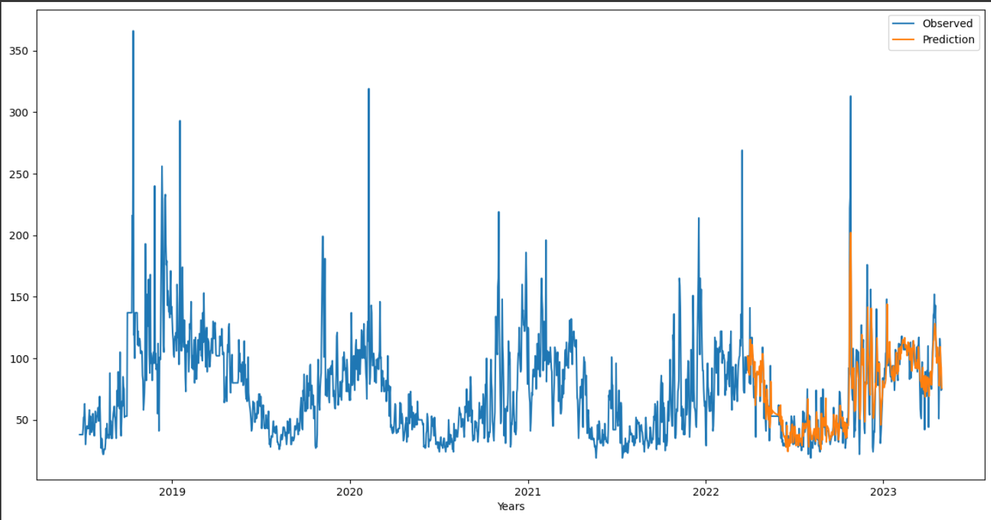
RESULT

Slide 13
SCIENCE & TECHNOLOGY COMPONENT / INNOVATIVENESS / NOVELTY OF THE PROJECT
This is the first time AQI has been modeled for a specific location. Until now, it was modeled for Bangalore as a whole, and going by government data, that was not accurate as different localities had different values.
The usage of exogenous variables to predict AQI is another novel approach as all the current works use a basic Time Series approach.
Another problem that we are tackling is that, right now there is no place where we can access the future levels of AQI. Hence we are creating a free to use web application that will show the current AQI and the forecasted AQI.
We are also providing the controls and measures to be taken when the AQI is at a particular value and how it can be brought back down to the recommended level.

Slide 14
SCIENCE & TECHNOLOGY COMPONENT / INNOVATIVENESS / NOVELTY OF THE PROJECT
Integrating the AQI forecast into Google Maps. Just like how Google gives push notifications of the weather rain forecast, it should give AQI forecasts as well.
Automating the complete line of work, the device and model should work without any human interference, except for maintenance.
We have built only one IoT device and have implemented it in only one location. Once we have established the proof of concept with this one location, we hope we can implement this on a much larger scale, covering much larger areas.

